Slide 1


Slide 2

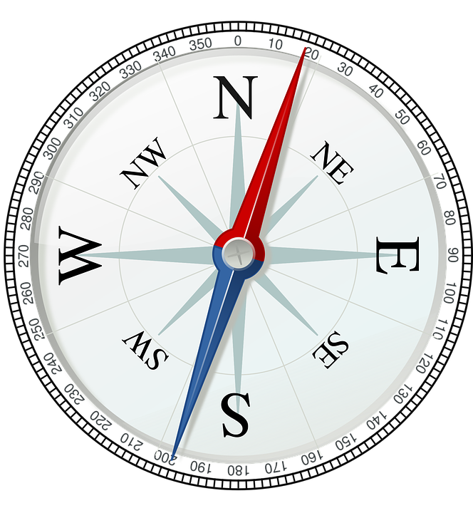
DIRECTION TEST

Slide 3
A man is facing towards west and turns through 45 clockwise, again 180° clockwise and then turns through 270 anti-clockwise. In which direction is he facing now ?
(a) West (b) North-west
(c) South (d) South-west

Slide 4
Kunal walks 10 kilometers towards North. From there, he walks 6 kilometers towards South. Then, he walks 3 kilometers towards East. How far and in which direction is he with reference to his starting point?
(a) 5 km West (b) 5 km North-east
(c) 7 km East (d) 7 km West

Slide 5
(3) Rohan walks a distance of 3 km towards North, then turns to his left and walks for 2 km. He again turns left and walks for 3 km. At this point he turns to his left and walks for 3 km. How many kilometers is he from the starting point?
(a) 1 km (b) 2 km
(c) 3 km (d) 5 km

Slide 6
(4) Namita walks 14 m towards west, then turns to her right and walks 14 m and then turns to her left and walks 10 m. Again turning to her left she walks 14 m. What is the shortest distance (in meters) between her starting point and the present position?
(a) 10 m (b) 24 m
(c) 28 m (d) 38 m

Slide 7
(5) A man walks 1 km towards East and then he turns to South and walks 5 km. Again he turns to East and walks 2 km, after this he turns to North and walks 9 km. Now, how far is he from his starting point?
(a) 3 km (b) 4 km
(c) 5 km (d) 7 km

Slide 8
Laxman went 15 km to the west from his house, then turned left and walked 20 km. He then turned East and walked 25 km and finally turning left covered 20 km. How far was he from his house?
(a) 5 km (b) 10 km
(c) 40 km (d) 80 km

Slide 9
(7) A child is looking for his father. He went 90 m in the East before turning to his right. He went 20 m before turning to his right again to look for his father at his uncle's place 30 m from this point. His father was not there. From here he went 100 m to the North before meeting his father in a street. How far did the son meet his father from the starting point?
(a) 80 m (c) 140 m
(b) 100 m (d) 260 m

Slide 10
(8) Two buses start from the opposite points of a main road, 150 km apart. The first bus runs for 25 km and takes a right turn and then runs for 15 km. It then turns left and runs for another 25 km and takes the direction back to reach the main road. In the meantime, due to a minor breakdown, the other bus has run only 35 km along the main road. What would be the distance between the two buses at this point?
(a) 65 km (b) 75 km
(c) 80 km (d) 85 km

Slide 11
(9) Two ladies and two men are playing cards and are seated at North, East, South and West of a table. No lady is facing East. Persons sitting opposite to each other are not of the same gender. One man is facing South. Which directions are the ladies facing?
(a) East and West (b) South and East
(c) North and East (d) North and West

Slide 12
Directions (Questions 9 -12 ): Study the information given below carefully and answer the questions that follow:
A, B, C, D, E, F, G, H and I are nine houses. C is 2 km east of B. A is 1 km north of B and H is 2 km south of A. G is 1 km west of H while D is 3 km east of G and F is 2 km north of G. I is situated just in middle of B and C while E is just in middle of H and D
(9) Distance between E and G is
(a) 1 km (b) 1.5 km
(c) 2 km (d) 5 km
Distance between E and I is
(a)1 km (b) 2 km
(c) 3 km (d) 4 km
(11) Distance between A and F is
(a) 1 km (b) 1.41 km
(c) 2 km (d) 3 km

Slide 13
A clock is so placed that at 12 noon its minute hand points towards north-east. In which direction does its hour hand point at 1.30 p.m.?
(a) North (b) South
(c) East (d) West

Slide 14
(13) It is 3 o'clock in a watch. If the minute hand points towards the North-east, then the hour hand will point towards the
(a) South (b) South-west
(c) North-west (d) South-east

Slide 15
(14) One morning after sunrise, Reeta and Kavita were talking to each other face to face at Tilak Square. If Kavita's shadow was exactly to the right of Reeta, which direction Kavita was facing?
(a) North (b) South
(c) East (d) Data inadequate

Slide 16
(15) Anuj started walking positioning his back towards the sun. After some time, he turned left, then turned right and then towards the left again. In which direction is he going now ?
(a) North or South (b) East or West
(c) North or West (d) South or West

Slide 17
(16) Johnson left for his office in his car. He drove 15 km towards north and then 10 km towards west. He then turned to the south and covered 5 km. Further, he turned to the east and moved 8 km. Finally, he turned right and drove 10 km. How far and in which direction is he from his starting point ?
(a) 2 km West (b) 3 km North
(c) 5 km East (d) 6 km south

Slide 18
(17) I start from my home and go 2 km straight. Then, I turn towards my right and go 1 km. I turn again towards my right and go 1 km again. If I am north-west from my house, then in which direction did I go in the beginning ?
(a) North (b) East
(c) South (d) South-east

Slide 19
The following questions
(18-20) are based on the diagram given below showing four persons stationed at the four corners of a square piece of plot as shown
C
A
E
N
B
D

Slide 20
(18) From the original position given in the above figure, A and B move one arm length clockwise and then cross over to the corner diagonally opposite; C and D move one arm length anti-clockwise and cross over the corner diagonally opposite. The original configuration ADBC has now changed to
(a) CBDA (b) BDAC
(c) DACB (d) ACBD

Slide 21
(19) From the positions in original figure, C and A move diagonally to opposite corners and then one side each clockwise and anti-clockwise respectively. B and D move two sides each clockwise and anti-clockwise respectively. Where is A now ?
(a) At the north-west corner
(b) At the north-east corner
(c) At the south-east corner
(d) At the south-west corner

Slide 22
(20) After the movements given in Q. 19 above, who is at the north-west corner ?
(a) A (b) B
(c) C (d) D

Slide 23


